Slide 1
Capstone 547 Introduction
Vidit Shah
Mittal Lab

Slide 2
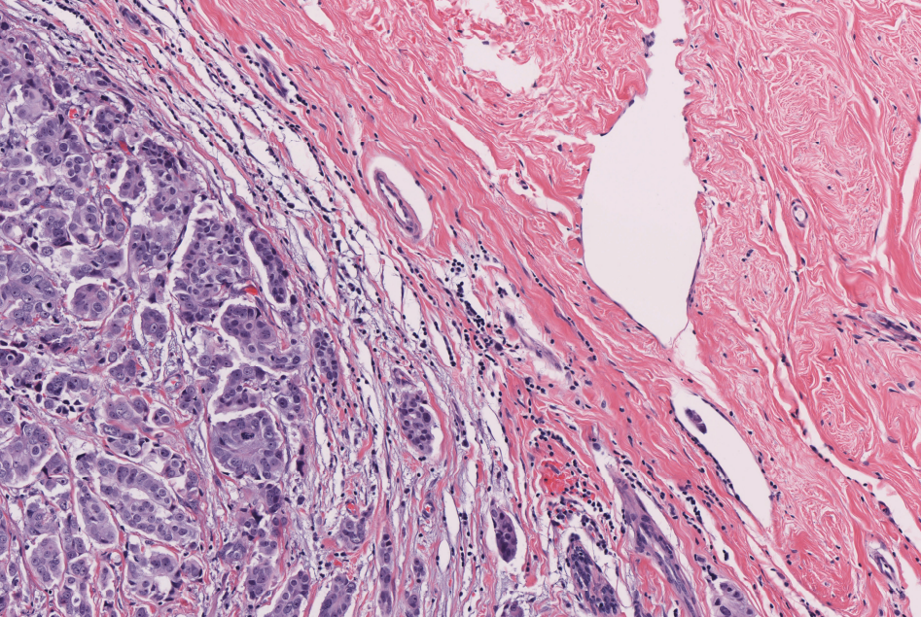
Reading H&E-stained image (.tif)

Slide 3
Clustering the Image
This step essentially helps us split image based on the colors associated with each pixel.
Open-CV has been used for this analysis.

Slide 4
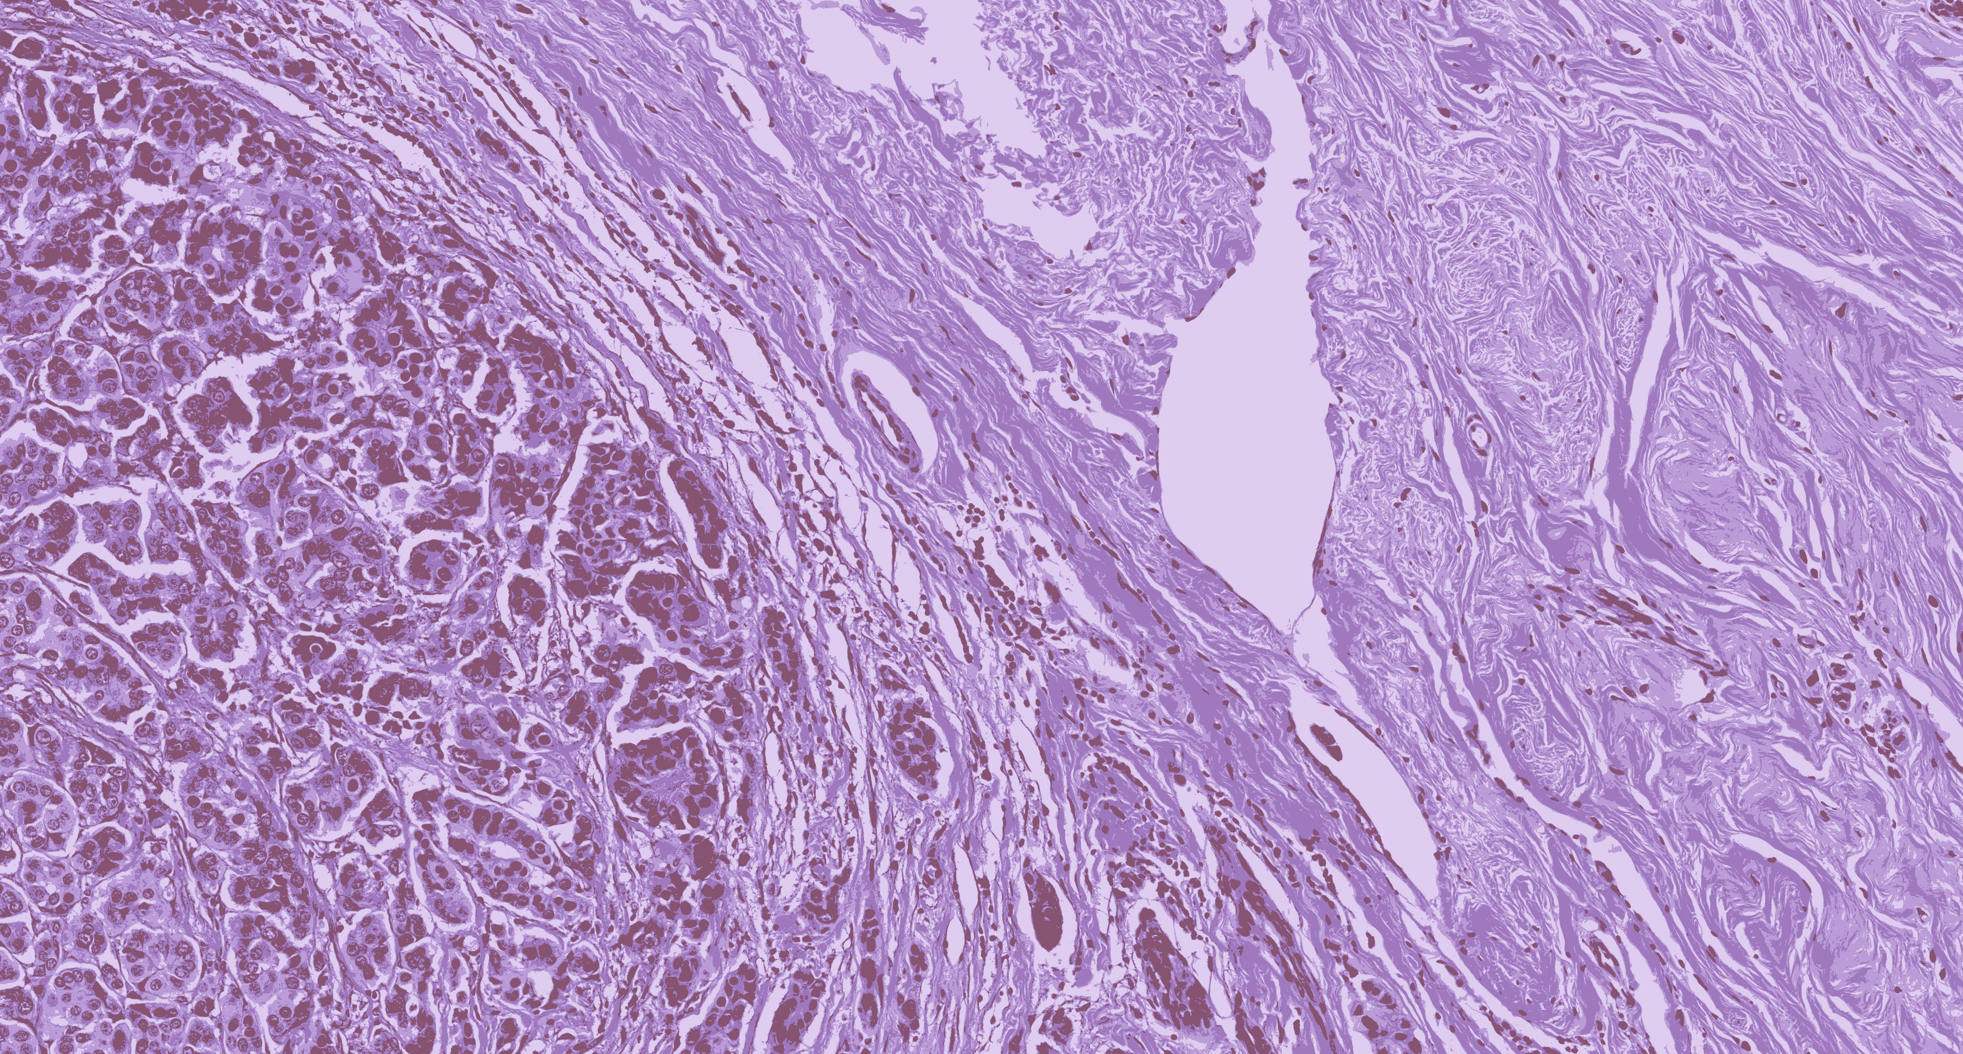
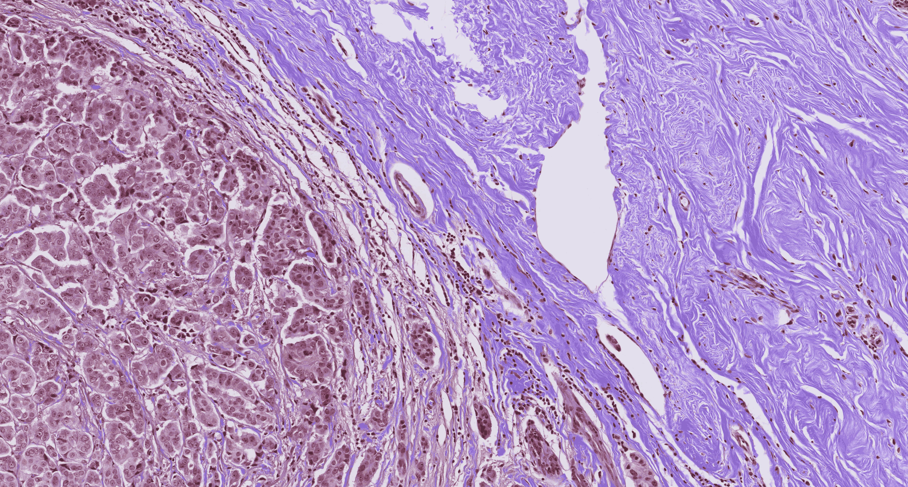
Comparing Clusters (4 & 19)

Slide 5
Significance
Each color essentially is supposed to signify that particular tissue component is different from other components (colors).
Now, as we see in previous slide it was very difficult to visualize all 19 colors in the cluster at once.
This makes us want to do something to visualize each cluster separately and infer what it actually signifies (If anything at all).

Slide 6
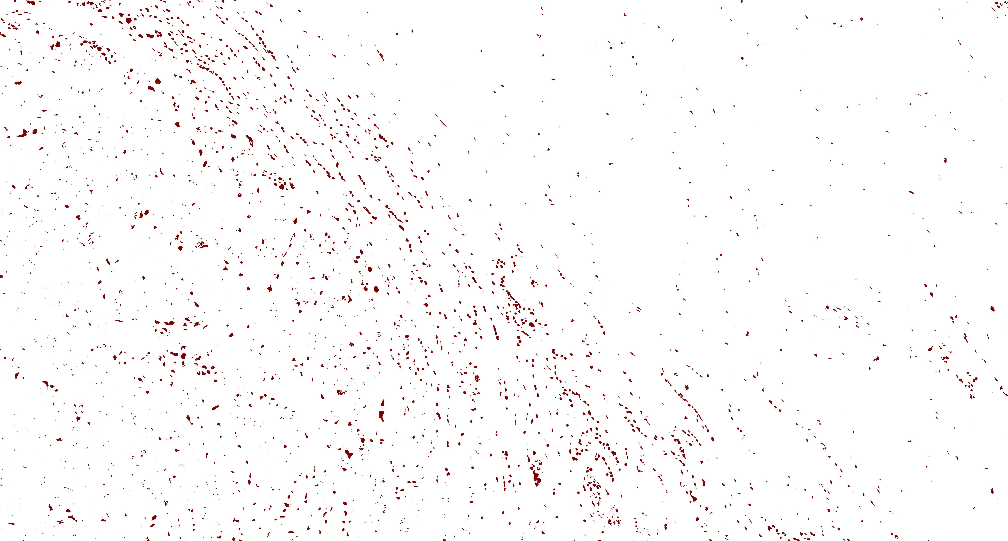
Visualizing Individual Clusters

Slide 7
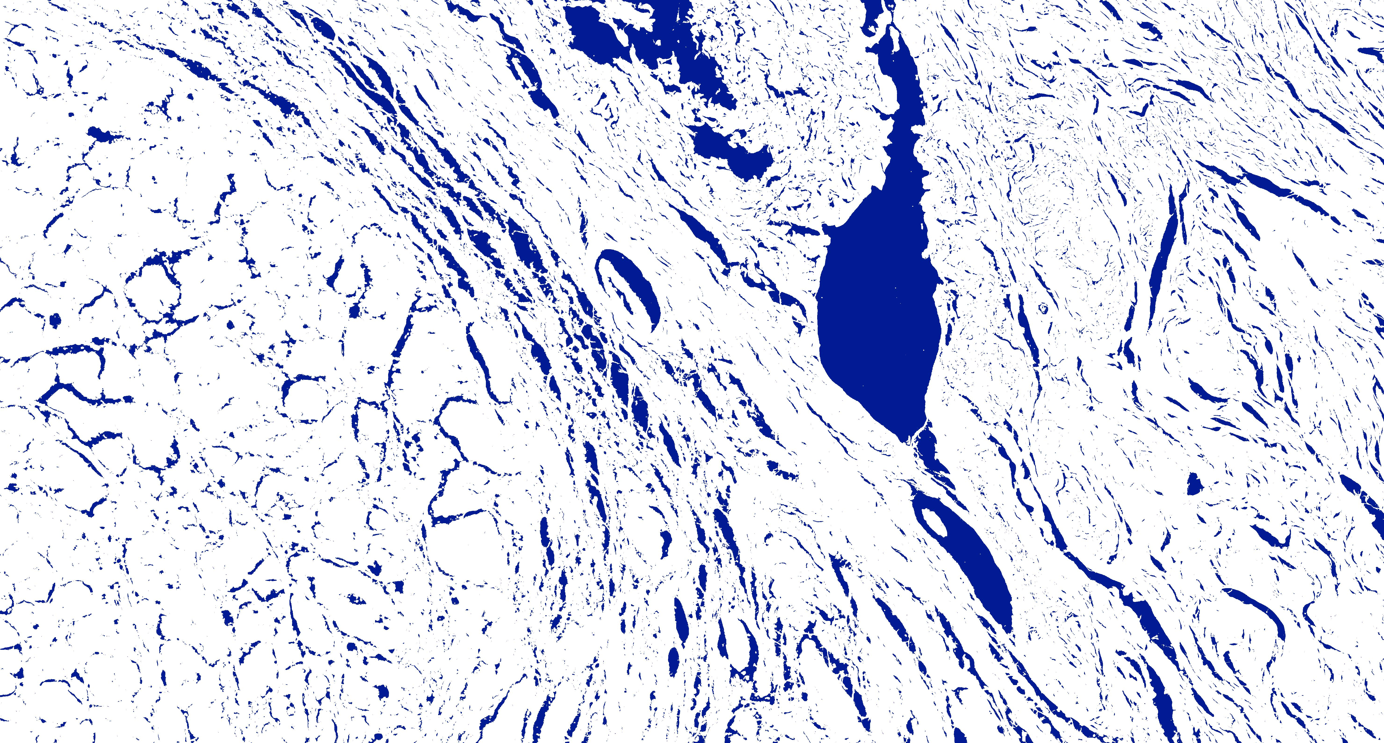
Visualizing Individual Clusters

Slide 8
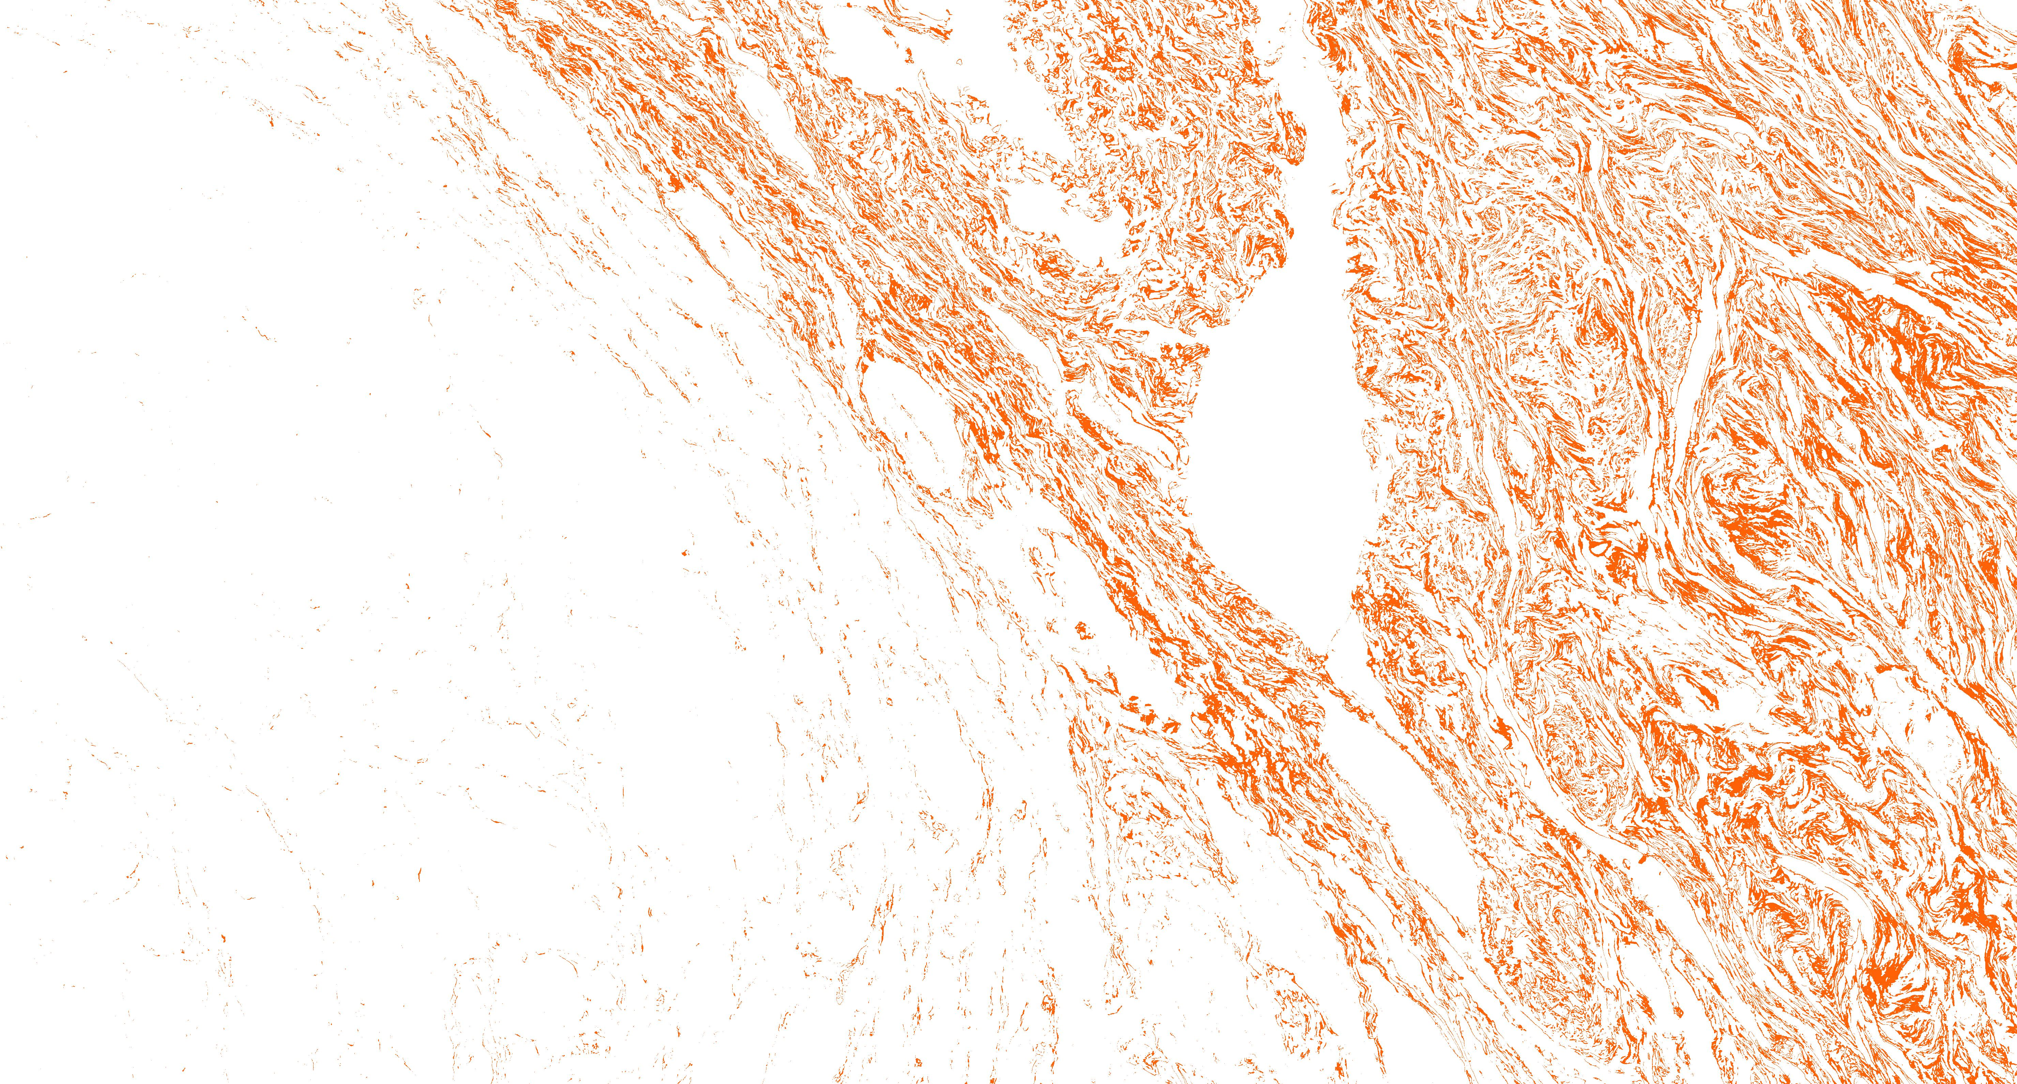
Visualizing Individual Clusters

Slide 9
Significance
This step essentially shows us that not all clusters will have a physical meaning/significance since these separations are merely based on Euclidean distances between values.
Hence, what we essentially need to do is further explore any of the obtained clusters which peak our interest and have a physical meaning.
This would prompt us to make clusters (sub-clusters) based for that cluster. (next few slides will clarify this.)

Slide 10
Remember This Cluster ???
Exactly!!!
This is the TIL cluster which we discussed a few slides ago.

Slide 11
Explanation
Now, since we colored all the pixels which a custom color, it will not be possible to further make clusters from this image.
We revert to the initial image and use the model to extract these pixels from that image based on the labels.

Slide 12

Original Image Pixels

Slide 13


Sub- Clusters

Slide 14
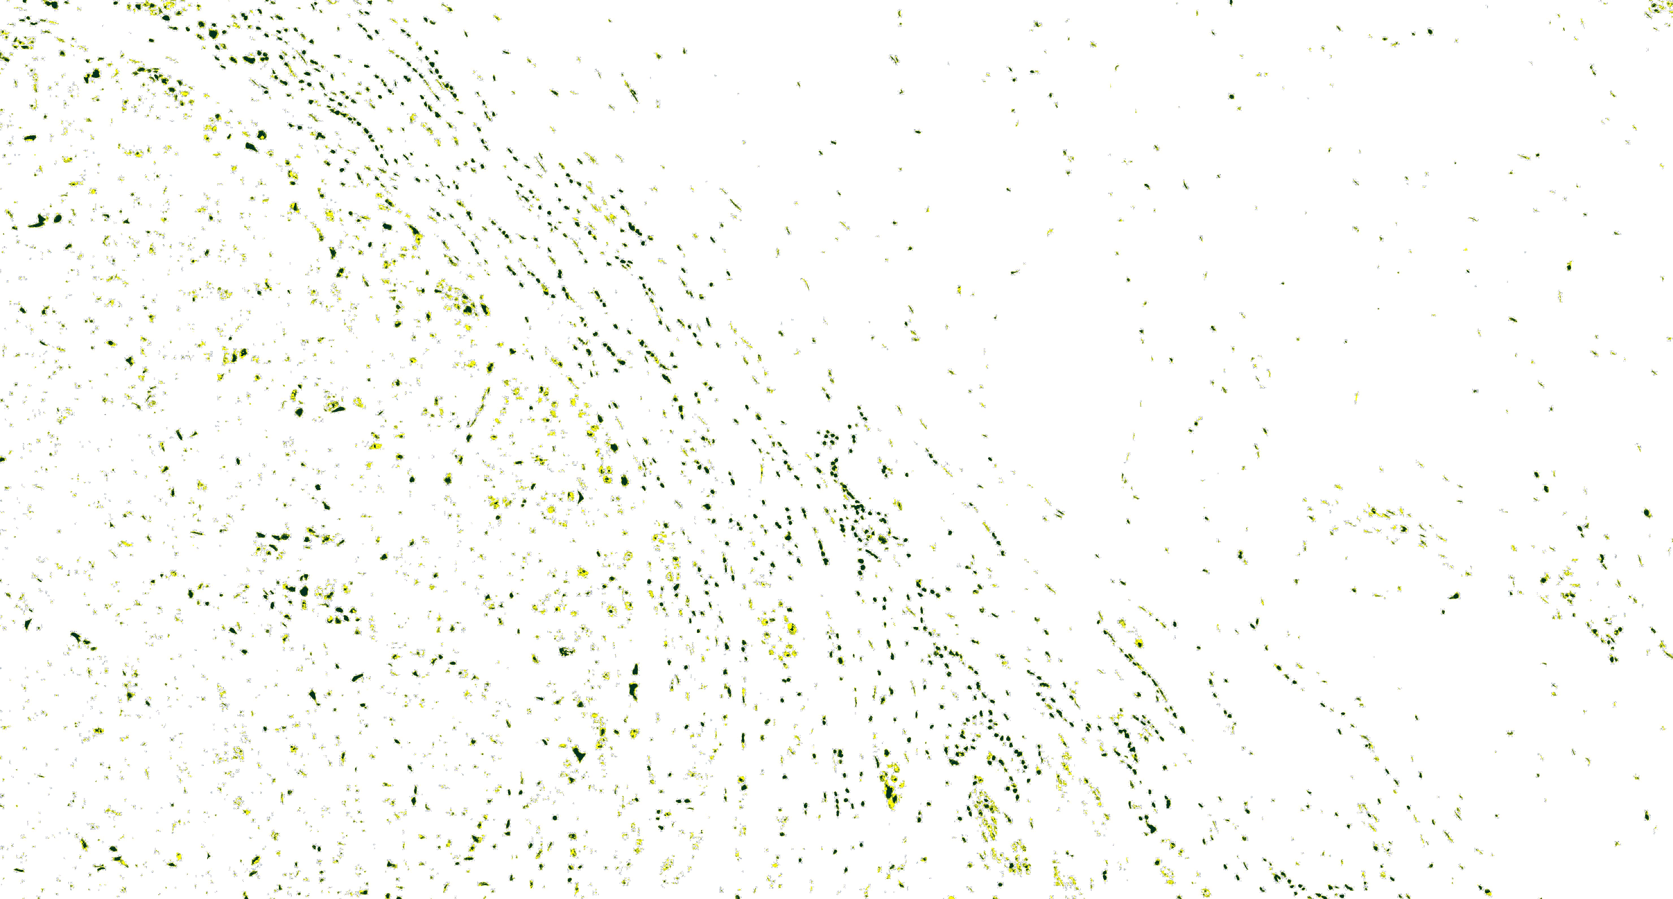
Visualizing clusters Together

Slide 15
Significance
We combine multiple clusters so we can overlay them together on the original H&E-stained image in question to better visualize and see how the model is performing.
This also gives us an intuition about the image which would have been less unlikely without visualizing simultaneously.

Slide 16
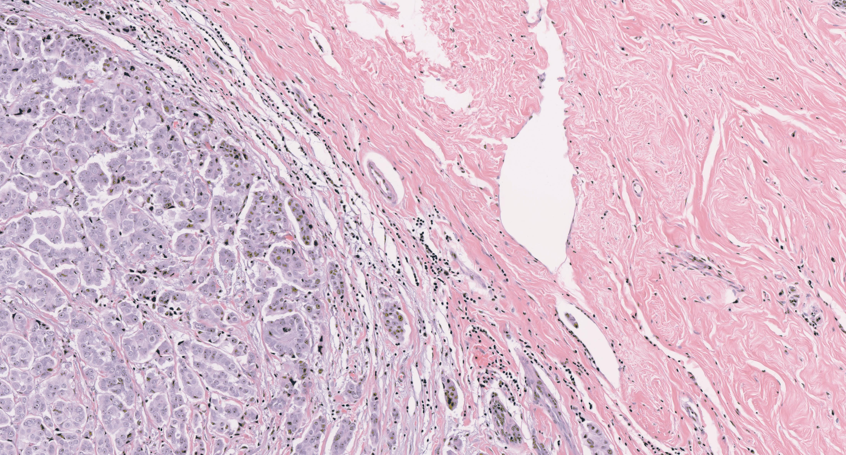
Overlayed Images

Slide 17
Basic Infrastructure
Python
Numpy
Open-CV (cv2)
Matplotlib

Slide 18

Questions !!!

